Slide 1
CS112: Introduction to Python programming
Week 4: data type I I

Slide 2
Contents
List
Tuples
Sets

Slide 3


Data collections
“data containers”
1. Lists （列表）
A sequence of objects (can be in different types; can have repetitions ), in a specific order; Lists can be modified
E.g.
2. Tuples （元组）
A sequence of objects in a specific order (like a list); but cannot be changed once created
E.g.
Notes:
list_a = [3.14,"Hello World",123,[1,2,3],'Hello World']
list_a
tuple_a = ("H20",18)
tuple_a

Slide 4
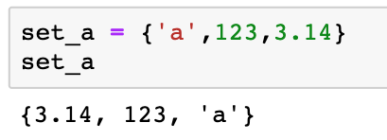
Data collections
“data containers”
3. Sets (集合)
A collection of objects (can be in different types, but cannot be repeated) in no particular order.
E.g.
Notes:
set_a = {'a',123,3.14}
set_a

Slide 5
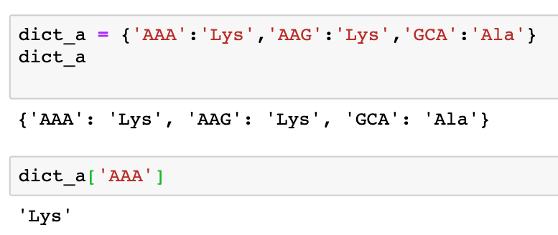
Data collections
“data containers”
4. Dictionaries （字典）
A look-up table to associate pairs of data objects (key : value)

Slide 6

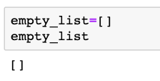
List
A list is an ordered collection of objects.
It is represented by elements separated by commas (,) and enclosed between square brackets ( [] ).
A list can hold different kinds of elements:

Slide 7
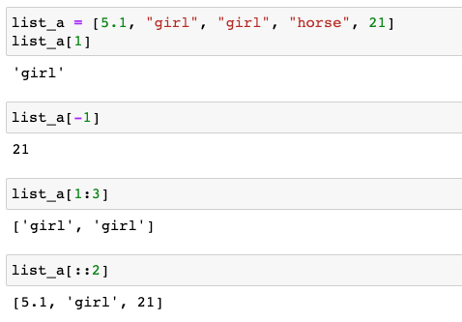
List indexing and slicing
Accessing list elements
As string, you cat get list elements by an index starting at zero.
Notes:
gene_list = ['ACTB','GAPDH','TP53','PTEN']
gene_list[1]

Slide 8
List indexing and slicing
Accessing list elements
You cat get list elements by an index starting at zero.
列出list中所有的元素
逆序列出list中所有的元素
Notes:
gene_list = ['ACTB','GAPDH','TP53','PTEN']
gene_list[1]

Slide 9

List indexing and slicing
Accessing list elements
To access an element that is inside a sequence, which is itself inside another sequence

Slide 10
List indexing and slicing
Accessing list elements
To access an element that is inside a sequence, which is itself inside another sequence

Slide 11
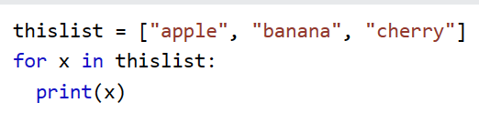
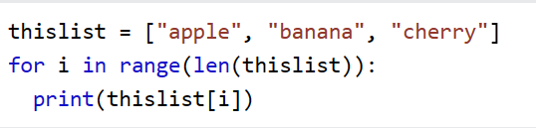
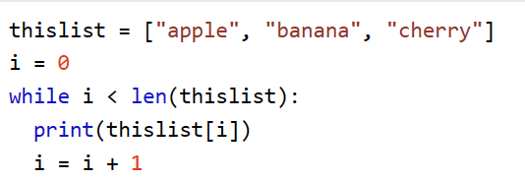
List index
Print all items in the list, one by one:
thislist = ["apple", "banana", "cherry"]
Print all items by referring to their index number:

Slide 12
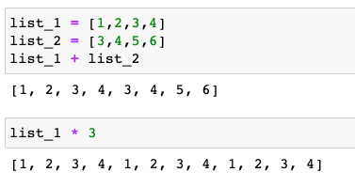
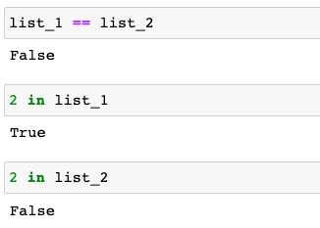
List operations
Lists can be concatenated using the + sign, and the * operator is used to create a repeated sequence of list:
Logical operations

Slide 13
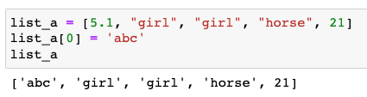

List modification
Lists are mutable. Unlike strings, lists can be modified by adding, removing, or changing their elements

Slide 14
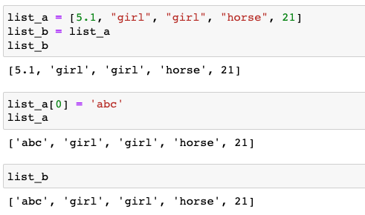
List modification
When you assign an existing list variable to a new variable, an assignment (=) on lists does not make a new copy. Instead, assignment makes both the variable names point to the same list in memory:

Slide 15
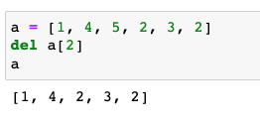
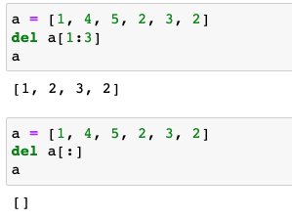
List modification
del statement removes an item from a list based on its index
The del statement can also be used to remove slices from a list or clear the entire list

Slide 16

Built-in functions for list
len(): Return the number of items in a list

Slide 17
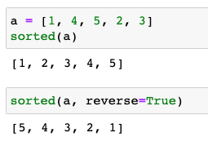
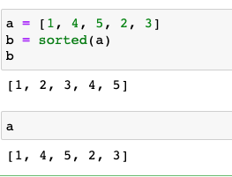
Built-in functions for list
sorted(): return a sorted list. Strings are sorted alphabetically, and numbers are sorted numerically.
The sorted() function returns a modified copy of the list while without modifying the original list

Slide 18
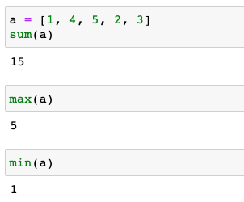
Built-in functions for list
sum(), max(), min() : return the sum, maximum or minimum of the items in a list

Slide 19
List methods
Python has a set of built-in methods that you can use on lists.
https://www.w3schools.com/python/python_lists_methods.asp

Slide 20
List methods
append(): Adds an element at the end of the list.
list.append(elmnt)
Parameter | Description
elmnt | Required. An element of any type (string, number, object etc.)
Notes:
gene_list = ['ACTB','GAPDH','TP53','PTEN']
gene_list.append('MAPT')
gene_list

Slide 21
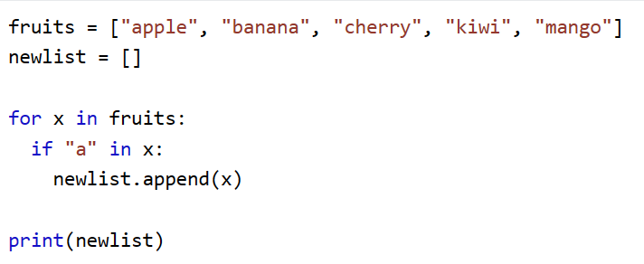
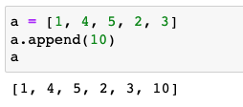
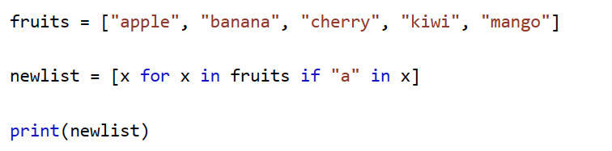
List methods
append(): Adds an element at the end of the list.
list.append(elmnt)
Notes:
gene_list = ['ACTB','GAPDH','TP53','PTEN']
gene_list.append('MAPT')
gene_list

Slide 22
List comprehension(列表推导式)
List comprehension is an elegant way to define and create lists based on existing lists. List comprehension is generally more compact and faster than normal functions and loops for creating list.
newlist = [expression for item in iterable if condition == True]
The if statement is optional, which acts as a filter that only accepts the items that valuate to True.
Notes:
列表推导式
squares = []
for x in range(1,8):
squares.append(x**2)
squares

Slide 23
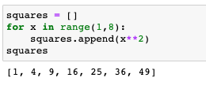

List comprehension(列表推导式)
newlist = [expression for item in iterable if condition == True]
E.g. Calculate the square for numbers from 1 to 7
For loop
List comprehension
Notes:
列表推导式
squares = []
for x in range(1,8):
squares.append(x**2)
squares

Slide 24
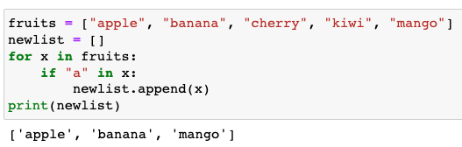
List comprehension(列表推导式)
newlist = [expression for item in iterable if condition == True]
E.g. Based on a fruit list, create a new list that contains only the fruits with the letter "a" in the name.
For loop
Notes:
列表推导式
squares = []
for x in range(1,8):
squares.append(x**2)
squares

Slide 25
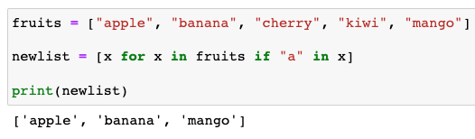
List comprehension(列表推导式)
newlist = [expression for item in iterable if condition == True]
E.g. Based on a fruit list, create a new list that contains only the fruits with the letter "a" in the name.
List comprehension
Notes:
列表推导式
squares = []
for x in range(1,8):
squares.append(x**2)
squares

Slide 26
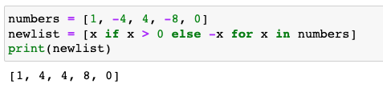
List comprehension(列表推导式)
newlist =
[expression1 if condition1 else expression2 for item in iterable]
E.g. From a list of numbers, convert negative numbers to their absolute values and leave the positive numbers unchanged.
List comprehension
Notes:
列表推导式
squares = []
for x in range(1,8):
squares.append(x**2)
squares

Slide 27
List methods
insert(): inserts the element at the specified position.
list.insert(pos, elmnt)
Parameter | Description
pos | Required. A number specifying in which position to insert the value
elmnt | Required. An element of any type (string, number, object etc.)
Notes:
gene_list = ['ACTB','GAPDH','TP53','PTEN']
gene_list.insert(2,'MAPT')
gene_list

Slide 28
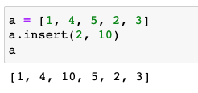
List methods
insert(): inserts the element at the specified position.
list.insert(pos, elmnt)
Notes:
gene_list = ['ACTB','GAPDH','TP53','PTEN']
gene_list.insert(2,'MAPT')
gene_list

Slide 29
List methods
pop(): removes the element at the specified position.
list.pop(pos)
Parameter | Description
pos | Optional. A number specifying the position of the element you want to remove, default value is -1, which returns the last item

Slide 30
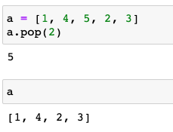
List methods
pop(): removes and returns the element at the specified position.
list.pop(pos)

Slide 31
List methods
remove(): removes the first occurrence of the element with the specified value. Unlike pop(), this function does not return anything.
list.remove(elmnt)
Parameter | Description
elmnt | Required. Any type (string, number, list etc.) The element you want to remove
Notes:
gene_list = ['ACTB','GAPDH','TP53','PTEN']
gene_list.remove('ACTB')
gene_list

Slide 32
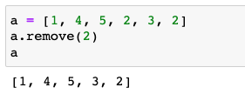
List methods
remove(): removes the first occurrence of the element with the specified value. Unlike pop(), this function does not return anything.
list.remove(elmnt)
Notes:
gene_list = ['ACTB','GAPDH','TP53','PTEN']
gene_list.remove('ACTB')
gene_list

Slide 33
List methods
count(): returns the number of elements with the specified value.
list.count(value)
Parameter | Description
value | Required. Any type (string, number, list, tuple, etc.). The value to search for.

Slide 34

List methods
count(): returns the number of elements with the specified value.
list.count(value)

Slide 35
List methods
index(): returns the position at the first occurrence of the specified value.
list.index(elmnt)
Parameter | Description
elmnt | Required. Any type (string, number, list, etc.). The element to search for

Slide 36

List methods
index(): returns the position at the first occurrence of the specified value.
list.index(elmnt)

Slide 37
List methods
sort() : sorts the list
list.sort(reverse=True|False, key=myFunc)
Parameter | Description
reverse | Optional. reverse=True will sort the list descending. Default is reverse=False
key | Optional. A function to specify the sorting criteria(s)

Slide 38
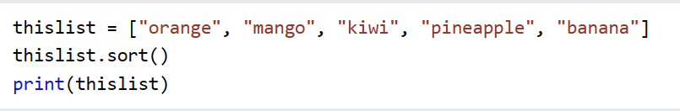
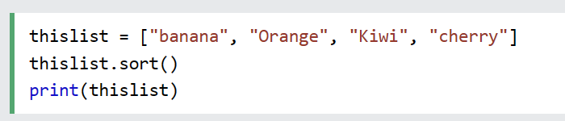
List methods
sort() : sorts the list
list.sort(reverse=True|False, key=myFunc)

Slide 39
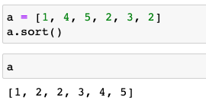
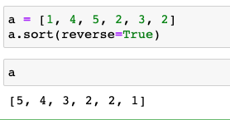
List methods
sort() : sorts the list
list.sort(reverse=True|False, key=myFunc)

Slide 40
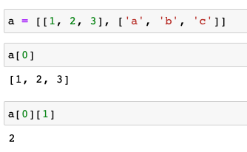
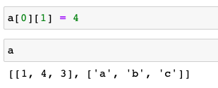
Nested lists
Multidimensional lists, or lists of lists:

Slide 41
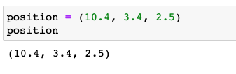
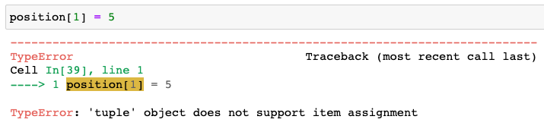
Tuple (元组)
A tuple is a collection of ordered objects with the characteristic that once created, it cannot be modified.
“Immutable lists”
Tuple’s elements are enclosed between parentheses ( ):

Slide 42


Tuple (元组)
A tuple is a collection of ordered objects with the characteristic that once created, it cannot be modified.
“Immutable lists”
Tuple’s elements are enclosed between parentheses ( ):

Slide 43
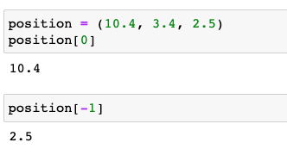
Tuple indexing and slicing
Indexing

Slide 44
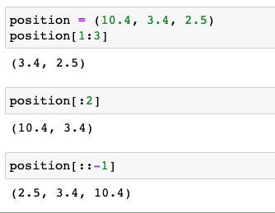
Tuple indexing and slicing
slicing

Slide 45
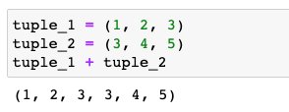
Tuple operations
Like in lists, you can use the + operator to concatenate tuples:
a new tuple returned

Slide 46

Tuple operations
You can also use the * operator to repeat a tuple:

Slide 47
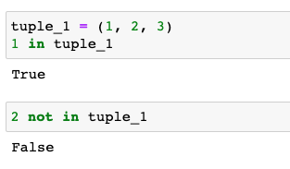
Tuple operations
You can check for the presence of an item in a tuple using in and not in membership operators:

Slide 48
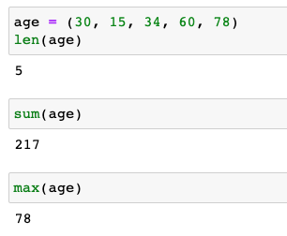
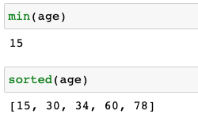
Built-in functions for tuples
len() function returns the numbers of items in a tuple
sum(), max(), min() function returns the sum/maximum/minimum of numbers in the tuple
sorted() function returns a sorted copy of the tuple as a list while leaving the original tuple unchanged

Slide 49
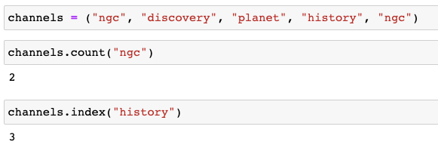
Tuple methods
count() : counts the number of times the item has occurred in the tuple and returns it
index(): searches for the given item from the start of the tuple and returns its first appearance index

Slide 50
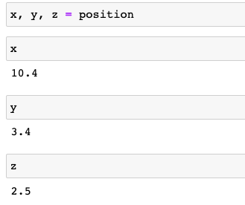

Tuple packing and unpacking
When we create a tuple, we normally assign values to it. This is called "packing" a tuple. In Python, we are also allowed to extract the values back into variables. This is called "unpacking"

Slide 51
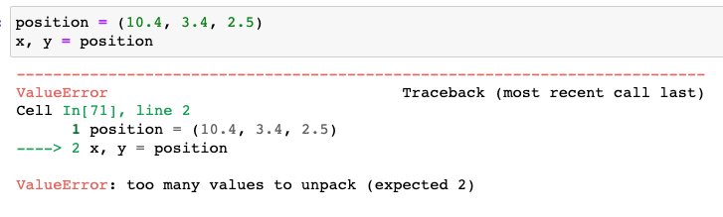
Tuple packing and unpacking
The number of variables must match the number of values in the tuple

Slide 52
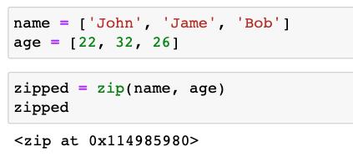
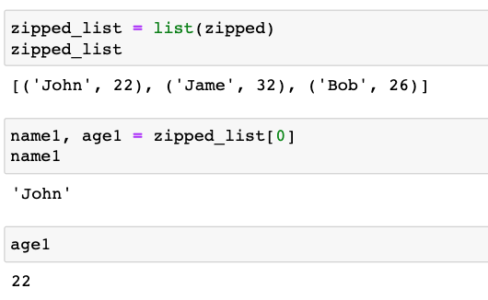
The zip() function
The zip() function returns a zip object, which is an iterator of tuples where the first item in each passed iterator is paired together, and then the second item in each passed iterator are paired together etc.

Slide 53
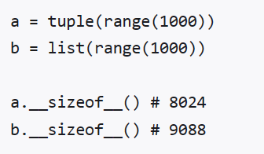
list和tuple区别
1.语法上的差别
2. 数据size上的差别 tuple更小
3.用法差异：tuples是immutable，list是mutable的，所以我们可以将tuples用作dictionary的key，但是list不可以
4.应用场景不同
tuples通常是存储异质元素（heterogeneous）的数据结构，而list通常存储同质元素（homogeneous）的数据结构
5.tuple用在很多需要保持数据不变的场合

Slide 54
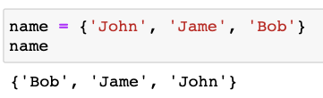
Set（集合）
A set is an unordered collection with no duplicate items
Differences compared to list :
1. unordered;
2. every element is unique;
3. set can contain unchangeable objects like number, string, tuple etc, but it cannot contain changeable objects such as list and dictionary.
Creating a set using curly braces {}
{ element1, element2, element3}

Slide 55
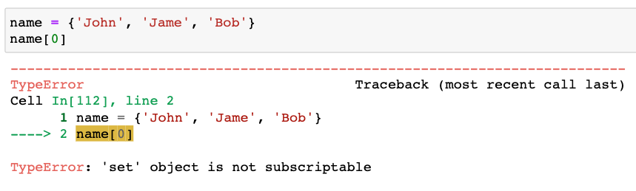
Set（集合）
Primary uses of sets include membership testing and eliminating duplicate entries.
Indexing is not possible in sets, since set items are unordered
You cannot access or change an item of the set using indexing or slicing

Slide 56
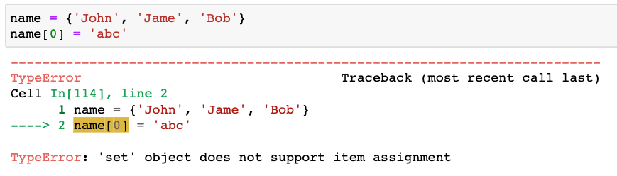
Set（集合）
Primary uses of sets include membership testing and eliminating duplicate elements.
Indexing is not possible in sets, since set items are unordered
You cannot access or change an item of the set using indexing or slicing

Slide 57
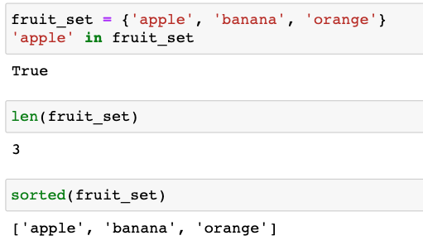
Set operations
in and not in
len()
sorted()

Slide 58


Set operations
Intersection: intersection() or &

Slide 59


Set operations
Union: union() or |

Slide 60


Set operations
Difference: difference() or -

Slide 61


Set operations
Symmetric Difference: symmetric_difference() or ^

Slide 62
Set methods
https://www.w3schools.com/python/python_sets_methods.asp
add(): adds an element to the set. If the element already exists, the add() method does not add the element.
set.add(elmnt)
Parameter | Description
elmnt | Required. The element to add to the set

Slide 63


Set methods
https://www.w3schools.com/python/python_sets_methods.asp
add(): adds an element to the set.
If the element already exists, the add() method does not add the element.
set.add(elmnt)

Slide 64
Set methods
https://www.w3schools.com/python/python_sets_methods.asp
add(): adds an element to the set. If the element already exists, the add() method does not add the element.
set.add(elmnt)

Slide 65
Set methods
remove(): removes the specified element from the set. Will raise an error if the specified item does not exist.
set.remove(item)
Parameter | Description
item | Required. The item to search for, and remove

Slide 66

Set methods
remove(): removes the specified element from the set. Will raise an error if the specified item does not exist.
set.remove(item)

Slide 67
Set methods
discard(): removes the specified item from the set; will not raise an error if the specified item does not exist.
set.discard(value)
Parameter | Description
value | Required. The item to search for, and remove

Slide 68

Set methods
discard(): removes the specified item from the set; will not raise an error if the specified item does not exist.
set.discard(value)

Slide 69

Converting between a Set and a List
To eliminate duplicate elements in a list

Slide 70

Converting a String to a Set

Slide 71


Converting between a String and a List
List to string:
string.join(iterable): takes all items in an iterable and joins them into one string using string as the separator .
String to list

Slide 72
More practice
https://pynative.com/python-list-quiz/
https://pynative.com/python-tuple-quiz/
https://pynative.com/python-set-quiz/
http://www.coolpython.net/python_primary/data_type/str_exercises.html

